Slide 1
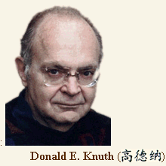
Introduction to complexity
Lecture 3
Prof. Sin-Min Lee
Department of Computer Science
San Jose State University

Slide 2


An Introduction
In the 1930’s before computers were used, mathematicians worked hard to formalize and study the concept of the algorithm.
  But what exactly is an algorithm?
  An algorithm is a precise set of instructions that leads to a solution. In other words, an algorithm is a precisely stated method for solving a problem.

Slide 3
"Fundamentally, computer science is the a science
of abstraction - creating the right model for
thinking about a problem and devising
the appropriate mechanizable techniques to
solve it.”
Alfred V. Aho, 1995

Slide 4
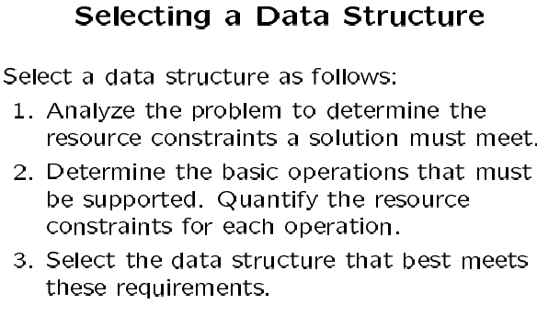

Slide 5
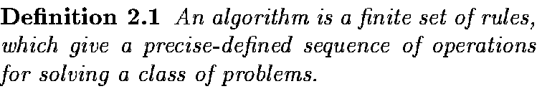
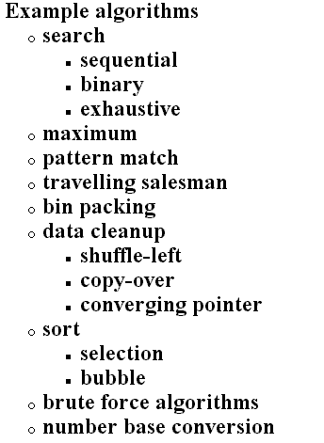
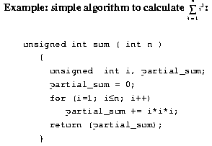

Slide 6
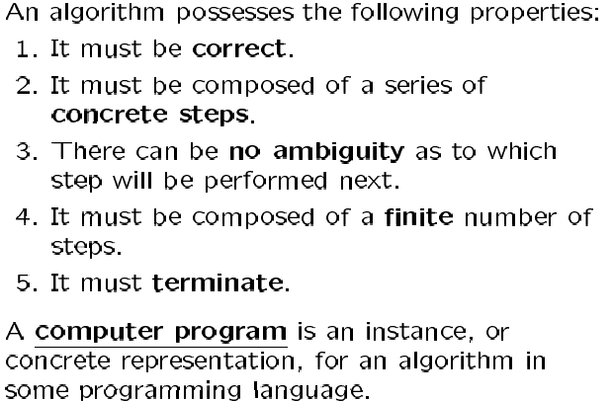

Slide 7
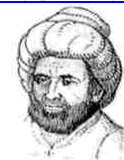
Analysis of Algorithms is a field in
computer science whose overall goal
is an understanding of the complexity
of algorithms. While an extremely
large amount of research is devoted
to worst-case evaluations,
The subject was founded by Knuth (who coined the term "analysis
of algorithms" in the mid-sixties) and is well illustrated by his
monumental series, The Art of Computer Programming
The field entertains close ties with a number of areas like discrete
mathematics, combinatorial analysis, probability theory, analytic
number theory, asymptotic analysis, complexity theory, and
sometimes statistical physics.

Slide 8
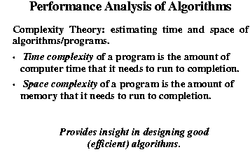

Slide 9
Donald Knuth
Among the heros of computer science is the algorithm master, Donald Knuth. He "wrote the book" in the early 70’s with his several volumes entitled The Art of Computer Programming, Vol… You will notice that he is referenced in essentially every book on data structures or algorithms because of his comprehensive cataloging and explanations of data structures.

Slide 11
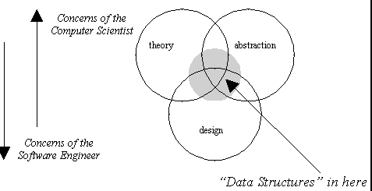

Slide 12
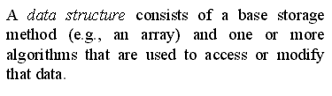
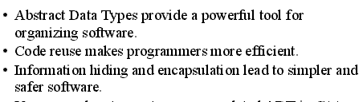

Slide 13
Data Structures and Algorithms
A data structure defines the admissible atomic steps and a control structure determines how these steps are to be combined to yield the desired algorithm. This view is stated very succinctly in the well known slogan ``algorithm = data structure + control''.

Slide 14
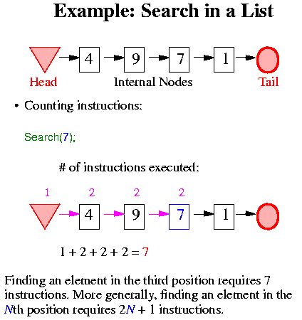

Slide 15
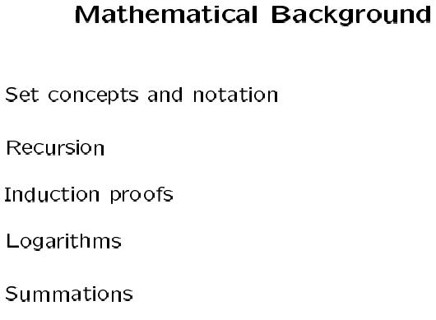

Slide 16
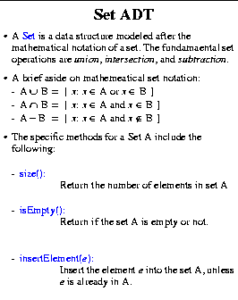

Slide 17
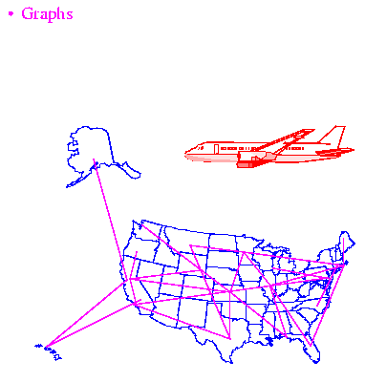

Slide 18
Recursion
Recursion is more than just a programming technique. It has two other uses in computer science and software engineering, namely:
as a way of describing, defining, or specifying things.
as a way of designing solutions to problems (divide and conquer).

Slide 19
Mathematical Examples
factorial function
factorial(0) = 1
factorial(n) = n * factorial(n-1) [for n>0]
Let's compute factorial(3). factorial(3)
= 3 * factorial(2)
= 3 * ( 2 * factorial(1) )
= 3 * ( 2 * ( 1 * factorial(0) ))
= 3 * ( 2 * ( 1 * 1 ) )) = 6

Slide 20
Fibonacci function:
fibonacci(0) = 1
fibonacci(1) = 1
fibonacci(n) = fibonacci(n-1) + fibonacci(n-2) [for n>1]
This definition is a little different than the previous ones because It has two base cases, not just one; in fact, you can have as many as you like.
In the recursive case, there are two recursive calls, not just one. There can be as many as you like.

Slide 21
Recursion
Recursion can be seen as building objects from objects that have set definitions. Recursion can also be seen in the opposite direction as objects that are defined from smaller and smaller parts. “Recursion is a different concept of circularity.”(Dr. Britt, Computing Concepts Magazine, March 97, pg.78)

Slide 22
Mathematical induction appears to have been known to the mathematicians of the Hellenistic times. More rigorous accounts of the process were provided several
centuries later by F. Maurolico (1494-1575) and B. Pascal (1623-1662).

Slide 23
Complexity: a measure of the performance of an algorithm
An algorithm’s performance depends on internal and external factors
Internal
The algorithm’s efficiency, in terms of:
Time required to run
Space (memory storage)
required to run
External
Size of the input to the
algorithm
Speed of the computer
on which it is run
Quality of the compiler
Complexity measures the internal factors
(usually more interested in time than space)

Slide 24
Introduction to complexity
Lecture 3
Prof. Sin-Min Lee
Department of Computer Science
San Jose State University

Slide 25
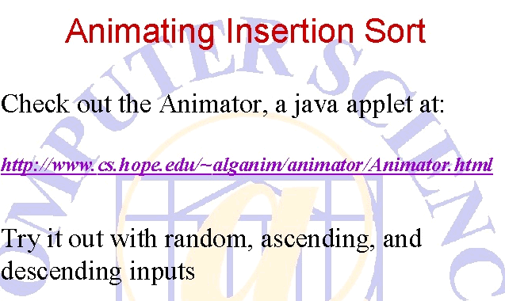

Slide 26
Growth rates and big-O notation
Growth rates capture the essence of an algorithm’s performance
Big-O notation indicates the growth rate. It is the class of mathematical formula that best describes an algorithm’s performance, and is discovered by looking inside the algorithm
Big-O is a function with parameter N, where N is usually the size of the input to the algorithm
  For example, if an algorithm depending on the value n has performance an² + bn + c (for constants a, b, c) then we say the algorithm has performance O(N²)
For large N, the N² term dominates. Only the dominant term is included in big-O

Slide 27
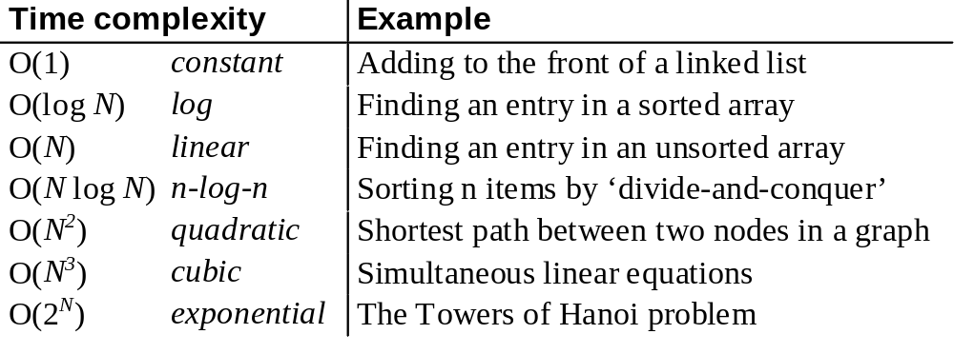
Common growth rates

Slide 28
Growth rates
O(N²)
O(Nlog N)
Time
Number of Inputs

Slide 29
Calculating the actual time taken by a program (example)
A program takes 10ms to process one data item (i.e. to do one operation on the data item)
How long would the program take to process 1000 data items, if time is proportional to:
  log₁₀ N
  N
  N log₁₀ N
  N²
  N³
(time for 1 item) x (big-O( ) time complexity of N items)

Slide 30
Best, average, worst-case complexity
In some cases, it is important to consider the best, worst and/or average (or typical) performance of an algorithm:
E.g., when sorting a list into order, if it is already in order then the algorithm may have very little work to do
The worst-case analysis gives a bound for all possible input (and may be easier to calculate than the average case)
Worst, O(N) or o(N): ≥ or > true function
Best, Ω(N): ≤ true function
Typical, Θ(N): ≅ true function *
* These approximations are true only after N has passed some value

Slide 31
How do we calculate big-O?
Five guidelines for finding out the time complexity of a piece of code
1 Loops
2 Nested loops
3 Consecutive statements
4 If-then-else statements
5 Logarithmic complexity

Slide 32
Guideline 1: Loops
The running time of a loop is, at most, the running time of the statements inside the loop (including tests) multiplied by the number of iterations.
for (i=1; i<=n; i++)
{
m = m + 2;
}
executed
n times
constant time
Total time = a constant c * n = cn = O(N)

Slide 33
Guideline 2: Nested loops
Analyse inside out. Total running time is the product of the sizes of all the loops.
for (i=1; i<=n; i++) {
for (j=1; j<=n; j++) {
k = k+1;
}
}
outer loop
executed
n times
inner loop
executed
n times
constant time
Total time = c * n * n * = cn² = O(N²)

Slide 34
Guideline 3: Consecutive statements
Add the time complexities of each statement.
constant time
x = x +1;
for (i=1; i<=n; i++) {
m = m + 2;
}
for (i=1; i<=n; i++) {
for (j=1; j<=n; j++) {
k = k+1;
}
}
executed
n times
constant time
outer loop
executed
n times
inner loop
executed
n times
constant time
Total time = c₀ + c₁n + c₂n² = O(N²)

Slide 35
Guideline 4: If-then-else statements
Worst-case running time: the test, plus either the then part or the else part (whichever is the larger).
test:
constant
if (depth( ) != otherStack.depth( ) ) {
return false;
}
else {
for (int n = 0; n < depth( ); n++) {
if (!list[n].equals(otherStack.list[n]))
return false;
}
}
then part:
constant
else part:
(constant +
constant) * n
another if :
constant + constant
(no else part)
Total time = c₀ + c₁ + (c₂ + c₃) * n = O(N)

Slide 36
Guideline 5: Logarithmic complexity
An algorithm is O(log N) if it takes a constant time to cut the problem size by a fraction (usually by ½)
Example algorithm (binary search):
finding a word in a dictionary of n pages
Look at the centre point in the dictionary
Is word to left or right of centre?
Repeat process with left or right part of
dictionary until the word is found

Slide 37
Performance isn’t everything!
There can be a tradeoff between:
  Ease of understanding, writing and debugging
  Efficient use of time and space
So, maximum performance is not always desirable
However, it is still useful to compare the performance of different algorithms, even if the optimal algorithm may not be adopted

